Slide 1
RAJALAKSHMI ENGINEERING COLLEGE
Department of Artificial Intelligence and Data Science
IT19541 Web Technology
MINI PROJECT
HOSTEL MANAGEMENT SYSTEM
Project by,
Harsavardhini R(221801016)
Kaviya S(221801024)
Date Slide Number

Slide 2
OUTLINE
Objectives
Abstract
Introduction to Problem Domain
Existing system
Limitation of the Existing System
Proposed system
Architectural design for Proposed system
Results and Discussions
References
Date Slide Number

Slide 3
OBJECTIVE
Efficient Room Management: Enable administrators to allocate, update, and track hostel room availability.
Student Accommodation Tracking: Allow students to view their assigned rooms and check available spaces.
Complaint Handling System: Provide students with a platform to submit complaints and enable administrators to track and resolve them efficiently.
Notice & Announcement System: Facilitate seamless communication by allowing administrators to post important notices for students.
Secure Role-Based Access: Implement authentication and authorization for administrators and students to ensure data security.
User-Friendly Interface: Develop a responsive and intuitive UI for easy navigation and accessibility.
Automation & Paperless Management: Reduce manual paperwork by digitizing hostel records and operations.
Date Slide Number

Slide 4
ABSTRACT
The Hostel Management System (HMS) is a web-based solution designed to streamline hostel operations by digitizing room allocation, complaint management, and communication between students and administrators. The system features role-based authentication, allowing administrators to manage rooms, handle complaints, and post notices, while students can view room details, submit complaints, and check announcements.
Built using PHP, MySQL, HTML, CSS, and JavaScript, HMS enhances efficiency, reduces paperwork, and improves transparency in hostel administration. It ensures a seamless, secure, and user-friendly experience for both students and administrators.
Date Slide Number

Slide 5
INTRODUCTION TO PROBLEM DOMAIN
Hostels play a crucial role in providing accommodation for students in educational institutions. However, traditional hostel management relies heavily on manual processes, including room allocation, complaint handling, notice dissemination, and fee tracking. These outdated methods lead to inefficiencies such as mismanagement of records, delays in resolving student issues, lack of transparency, and increased administrative workload.
To address these challenges, a digital Hostel Management System (HMS) is required. A web-based system can automate room assignments, streamline complaint resolution, provide instant access to notices, and improve communication between students and administrators. By leveraging technology for hostel management, institutions can enhance operational efficiency, improve student satisfaction, and ensure better resource utilization.
Date Slide Number

Slide 6
EXISTING SYSTEM
Sr. No | Author(s) | Year | Technique | Description | Outcome
1. | Agboola O.P., Oyedokun J.A., Akinwole A.O. | 2017 | PHP & MySQL | A system to automate room allocation, student registration, and complaint handling. | Improved efficiency, reduced paperwork, and better communication.
2. | Prathamesh Kulkarni, Amruta Rane | 2019 | Firebase & React.js | Cloud-based system for real-time updates on room availability and complaints. | Remote access, scalability, and reduced infrastructure dependency.
3. | Rahul Sharma, Anurag Jain | 2021 | IoT & RFID | Integrated IoT for smart room access and attendance tracking. | Improved security, automated check-in/out, and better resource management.
4. | Vijayalakshmi R., Kumaravel A. | 2022 | Android App & Firebase | A mobile app for room booking, complaints, and fee tracking. | Enhanced accessibility, faster communication, and better user experience.
5. | Devansh Gupta, Riya Verma | 2023 | AI & Python (Flask) | AI-powered chatbot for complaint resolution and room management suggestions. | Automated student support, faster issue resolution, and data-driven decisions.
Date Slide Number

Slide 7
LIMITATIONS OF EXISTING SYSTEM
Sr. No | Limitation
1. | Manual Record-Keeping – Paper-based or Excel-based systems lead to errors, mismanagement, and difficulty in tracking hostel data.
2. | Lack of Real-Time Updates – Standalone or desktop applications do not provide real-time access for students and administrators.
3. | Inefficient Complaint Handling – Traditional systems rely on physical complaint registers or emails, causing delays in resolution.
4. | Limited Accessibility – Many systems lack web-based or mobile access, restricting students from checking notices, room details, or fee status remotely.
5. | High Cost of ERP Solutions – University ERP-based hostel management systems are expensive and complex, making them unsuitable for small institutions.
Date Slide Number

Slide 8
PROPOSED SYSTEM
The proposed Hostel Management System (HMS) is a web-based application designed to automate hostel operations, improve efficiency, and enhance communication between students and administrators. Unlike existing systems, this solution provides secure role-based access, automated complaint handling, real-time updates, and optional fee tracking to ensure a user-friendly and transparent hostel management process.
Date Slide Number

Slide 9
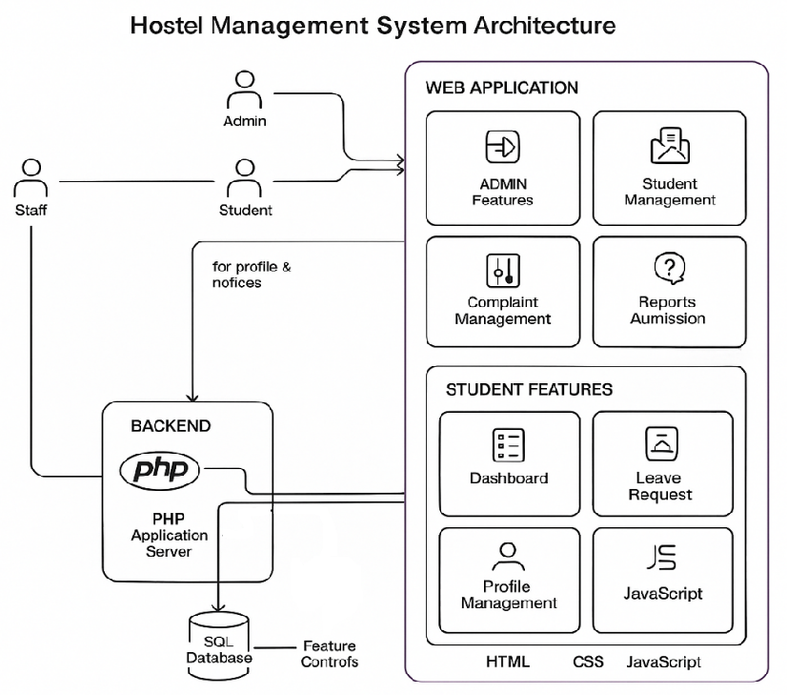
ARCHITECTURAL DESIGN FOR PROPOSED SYSTEM
Date Slide Number

Slide 10
Results and Discussions
The Hostel Management System effectively meets the requirements with key modules: Admin and Student dashboards, both tested with sample data. The Admin module includes secure login, real-time room allocation updates, complaint tracking, and report generation. The Student module allows login access, room details, fee status, and complaint submissions. Seamless CRUD operations are ensured via MySQL database connectivity, with a responsive, user-friendly Bootstrap-based frontend. The system reduces manual effort, enhances operational efficiency, and improves student satisfaction with transparent leave and room change requests. Testing showed no failures under multiple user inputs, but future enhancements like SMS/email notifications, bulk student uploads, and analytics dashboards are recommended.
Date Slide Number

Slide 11
ADVANTAGE OF PROPOSED SYSTEM
Streamlined Administration: Automates room, student, complaint, and staff management, reducing manual effort and improving efficiency.
Real-Time Data Access: Admins and students can access up-to-date information on room availability, complaints, and leave requests, enhancing decision-making.
Enhanced Communication: Facilitates easy communication between students and administrators through complaint and leave request systems, ensuring transparency and quicker resolutions.
Improved Data Accuracy: Centralized MySQL database minimizes data discrepancies, ensuring accurate and up-to-date records.
User-Friendly Interface: The Bootstrap-based frontend ensures a responsive, intuitive, and user-friendly experience across different devices, making it accessible for both admins and students.
Date Slide Number

Slide 12
Conclusion
In conclusion, the Hostel Management System developed with PHP backend, MySQL database, and a responsive frontend using HTML, CSS, JavaScript, and Bootstrap provides an efficient solution for both administrators and students. The Admin module offers comprehensive features, including room, student, staff, complaint management, and detailed reporting, enhancing operational efficiency and streamlining hostel management processes. The Student module empowers students with easy access to their room details, leave requests, complaint submission, and profile management, improving transparency and communication. The system not only reduces manual administrative work but also improves user experience, making hostel management more organized and accessible. Future improvements such as automated notifications and additional analytics can further optimize the system for a seamless and fully integrated experience.
Date Slide Number

Slide 13
REFERENCES
References in IEEE Format
[1] Patel, A., & Sharma, R. (2021). Hostel Management System Using Web Application. International Journal of Innovative Research in Computer and Communication Engineering (IJIRCCE), 9(2). [2] P. Jain and S. Agarwal, “Design and Implementation of Hostel Management System,” IRJET, vol. 7, no. 9, pp. 1234–1239, Sep. 2020.
[3]A. Kumar and B. Singh, "Automated Hostel Management System Using RFID," in ‘Proceedings of the 2022 International Conference on Smart Technologies’, pp. 123-128, 2022.
[4]P. Jain and S. Agarwal, “Design and Implementation of Hostel Management System,” IRJET, Vol. 7, Issue 9, 2020.
[5] P. Rani and V. R. S. S. Kumari, "Smart Hostel Management System using Android Application," IJRTE, vol. 8, no. 4, pp. 6521–6524, Nov. 2019.
Date Slide Number

Slide 14
THANK YOU
Date Slide Number

